Slide 1


Citizen science: grænsefladen mellem menneskelig og kunstig intelligens
Jacob Sherson
Big Bang 25/1-18

Slide 2

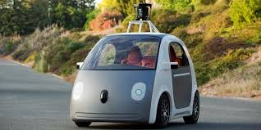
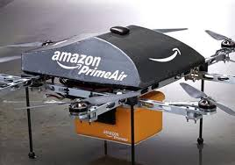

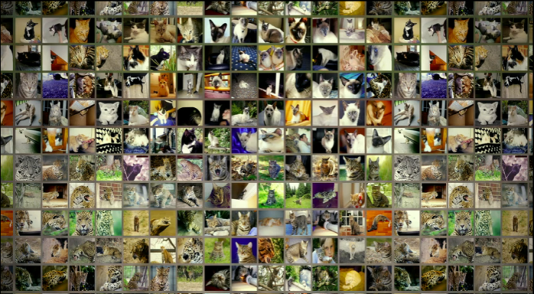
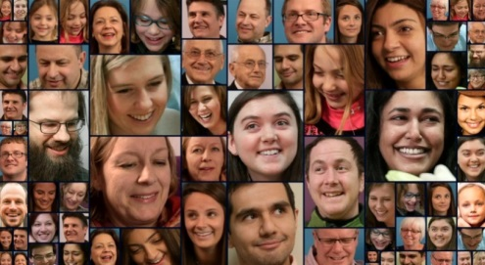


Central topic
Man vs Machine (AI)
Deep learning
Human uniqueness is under constant bombardment from improving AI

Slide 3

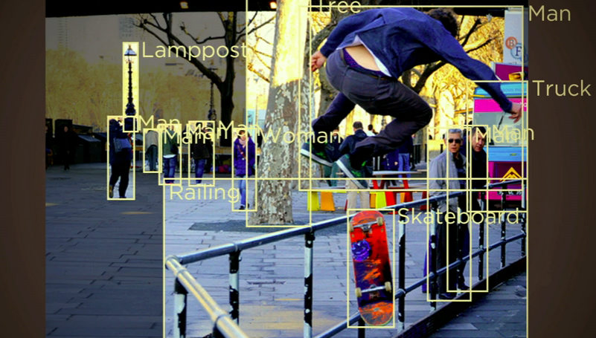
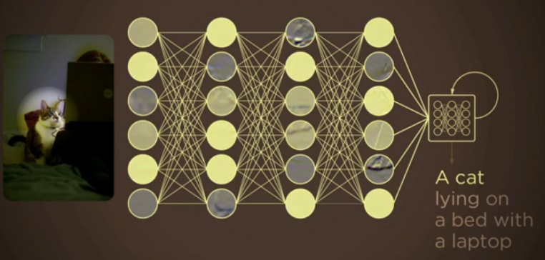
Smart computer vision: seeing means understanding
Need for big-data training: Humans record 5 pictures/sec
Towards human visual understanding:
Computer vision + machine learning of language recognition

Slide 4
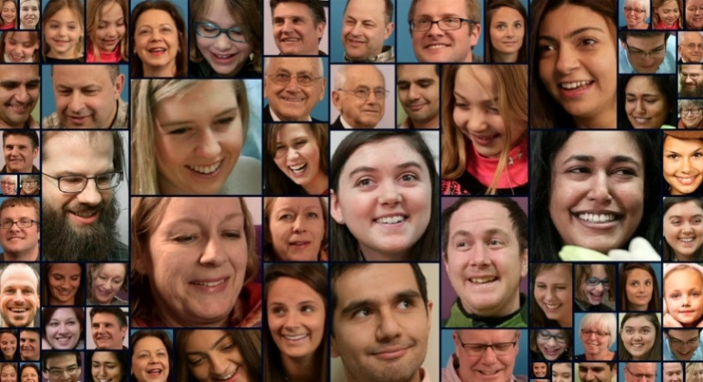
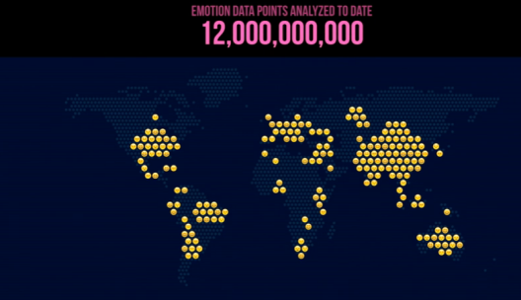
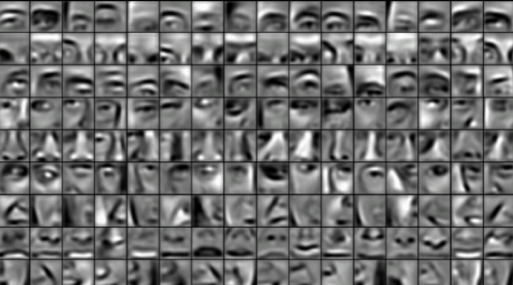
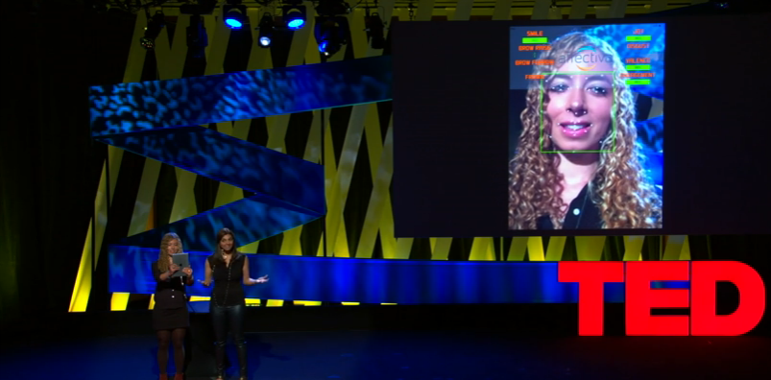

Emotional recognition in an app
3 mio face videos
Deep learning
Joy
Surprise
Anger
…
For:
Glasses for autistic people
Online learning system ”discovers” when we are bored
”Emotional-skype”
MIT-media lab spin-off

Slide 5
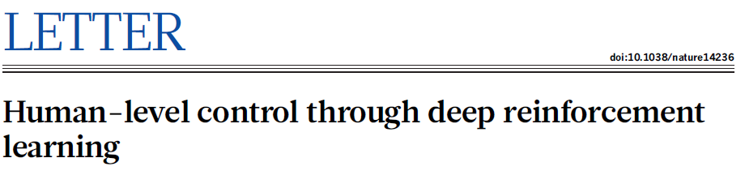
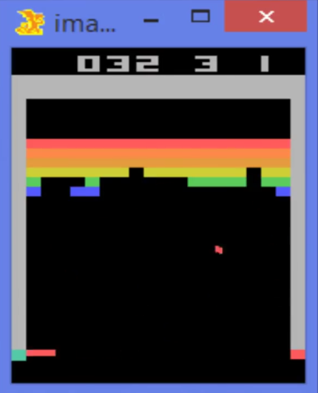
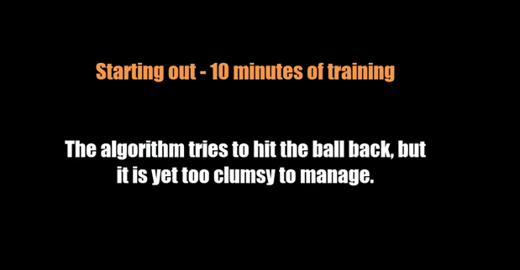
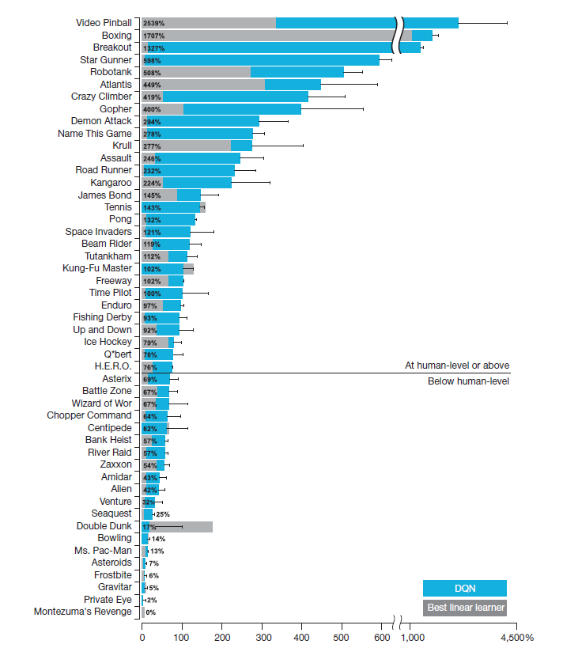
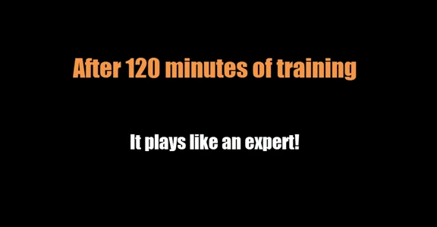
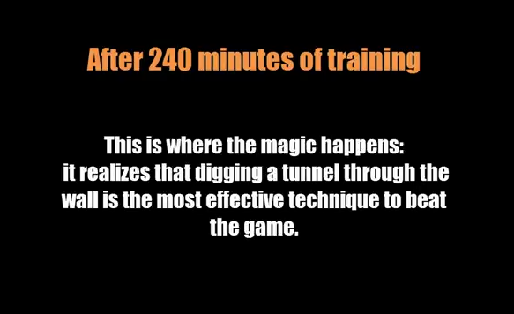
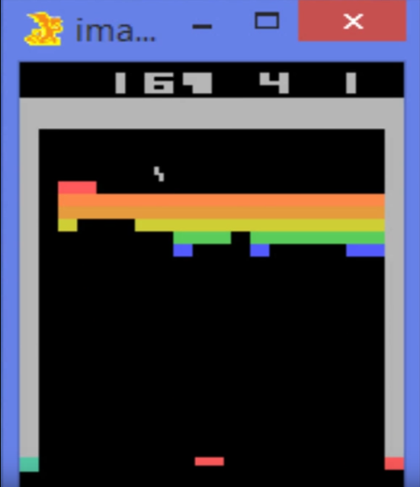
Google DeepMind
youTube: Google DeepMind's Deep Q-learning playing Atari Breakout

Slide 6
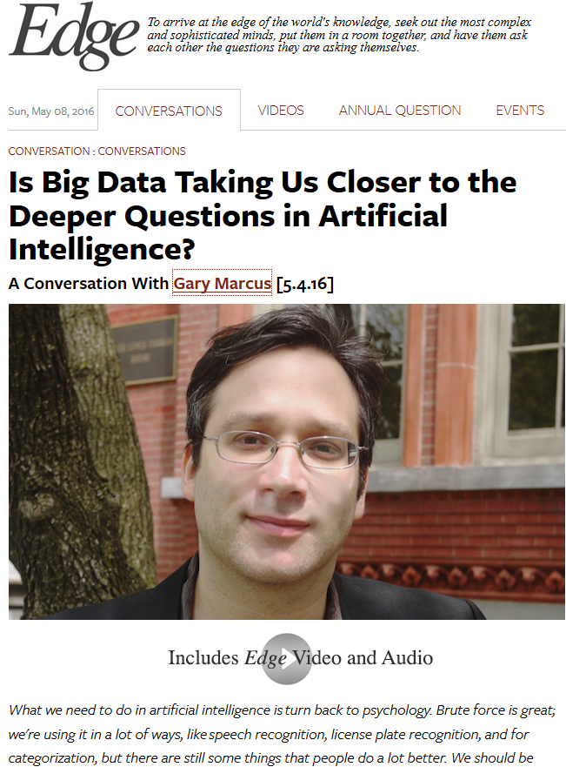

Learn more efficentlyfrom less data
Notes:
GARY F. MARCUS, scientist, bestselling author, and entrepreneur, is a professor of psychology and neural science at NYU and CEO and co-founder of the recently-formed Geometric Intelligence, Inc.

Slide 7
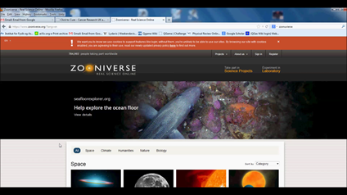

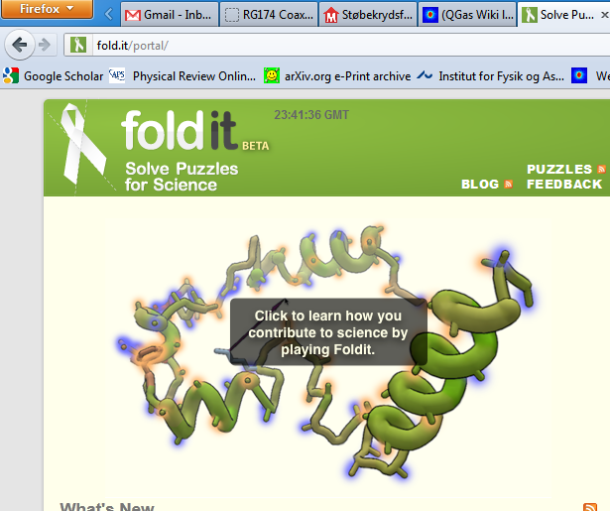
Human Computing / citizen science
3.000.000.000 hours spent on computer games every week
100.000.000 hours spent on making entire Wikipedia

Slide 8
Our overall strategy
Cognitive/social
Science – understanding human (inter)actions
Hybrid intelligence through Citizen
science
Machine learning
Natural science – high dimensional complex optimization
scienceathome.org
So far: 250k+ players

Slide 9
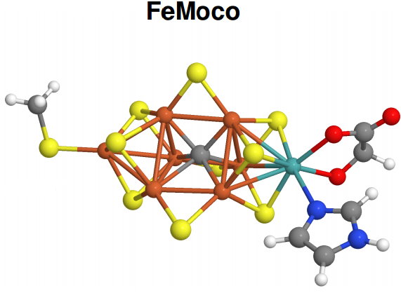
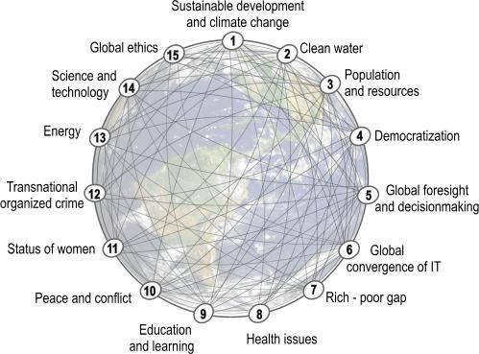
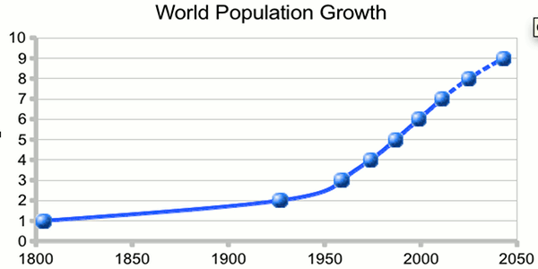

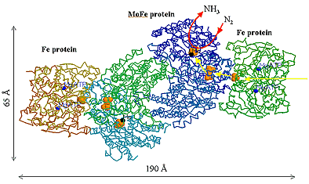

15 global challenges
CO2-absorbing organic batteries (fight global warming)
Production of fertilize, 2 % of world’s energy consumption today!
Industrial ammonia production
High temperature superconductor (sustainable green energy)
Nitrogenase
$$N_{2}+8H^{+}+8e^{−} 2NH_{3}+H_{2}$$
1 atm, ${20}^{o}C$
Design of new medicin
http://www.millennium-project.org/millennium/challeng.html

Slide 10
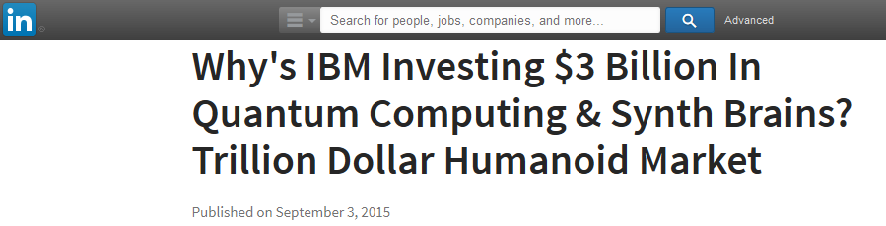

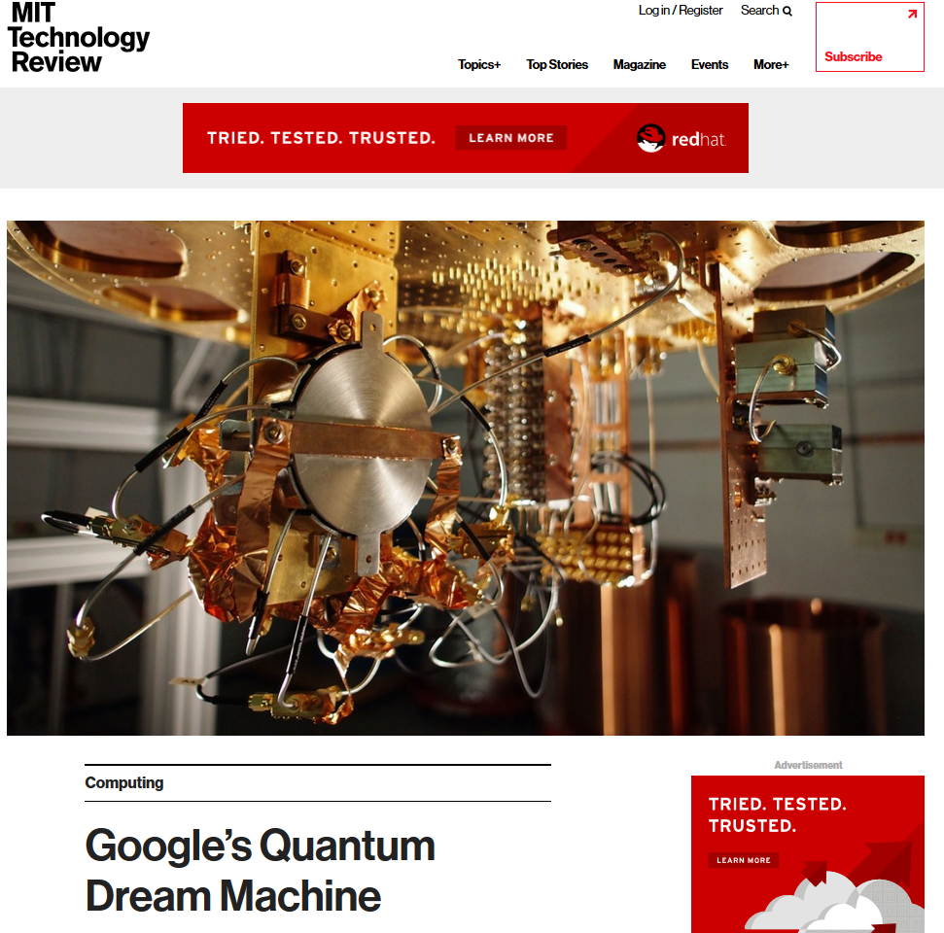
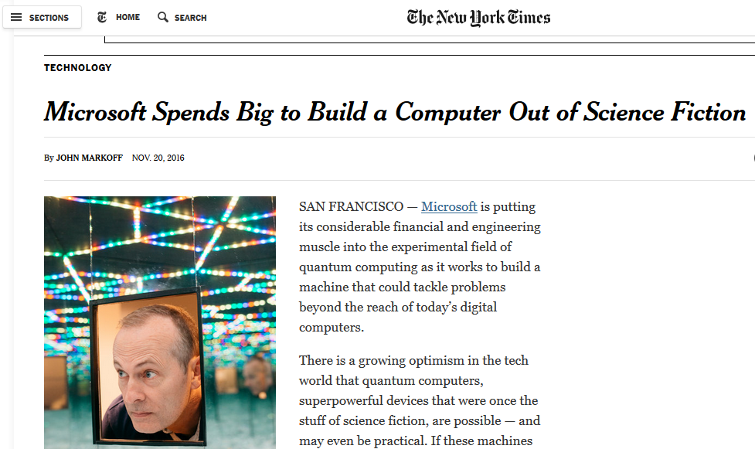
Everyone wants a quantum computer
Notes:
Feasibility of disruptive q tech, is underscored by…
Instead, the company hopes to create dependable tools that scientists without a quantum background can use to solve some of the world’s most difficult problems. By doing that, they believe they will help usher in a “quantum economy” that could revolutionize industries such as medicine and materials science. Read more at http://blogs.microsoft.com/next/2016/11/20/microsoft-doubles-quantum-computing-bet/#Drw8zdGVX5uUS6QZ.99
With effective quantum hardware and software, quantum experts say they could create vast computing power that could address some of the world’s most pressing problems, from climate change and hunger to a multitude of medical challenges.
That’s partly because the computers could emulate physical systems, speeding up things like drug development or our understanding of plant life. Researchers say the intelligent cloud could be exponentially more powerful, similar to how cell phones evolved into smart phones.
Read more at http://blogs.microsoft.com/next/2016/11/20/microsoft-doubles-quantum-computing-bet/#Drw8zdGVX5uUS6QZ.99
Using a quantum computer, Wecker said scientists think they could map the chemical used by bacteria that naturally creates fertilizers, making it easier to create an alternative to the current, natural-gas based synthetic fertilizer.
The incredible power of quantum computers also could be used to figure out how to create organic batteries that don’t rely on lithium, and Wecker said they could help to create systems for capturing carbon emissions effectively, potentially reducing the effects of climate change.
Read more at http://blogs.microsoft.com/next/2015/11/13/with-quantum-computing-simulator-microsoft-offers-a-sneak-peek-into-future-of-computing/#s0UmlusmGlZDT8JI.99

Slide 11
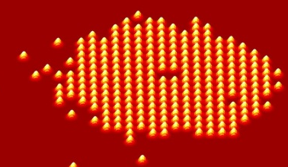
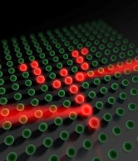
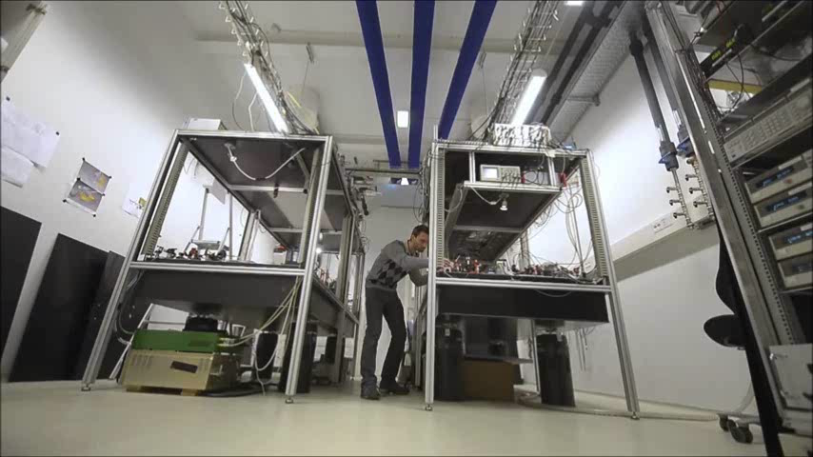
Our quantum computer in Aarhus
The coldest crystal in the world (~4nK)
Produced by Lundbeck Foundation, 2013
Notes:
I come from Aarhus which is a small town in the eastern part of Jutland. Everyone more or less knows everyone, and We smile a lot, so if you are ever in the neighborhood please stop by.
This is my lab. Ultracold atoms for q computer/simulator

Slide 12




Slide 13



Slide 14

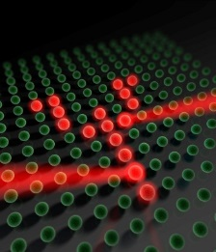
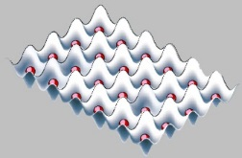
Concept:
The best solutions can be converted to electrical signals controlling the movement of a laser in the lab.

Slide 15
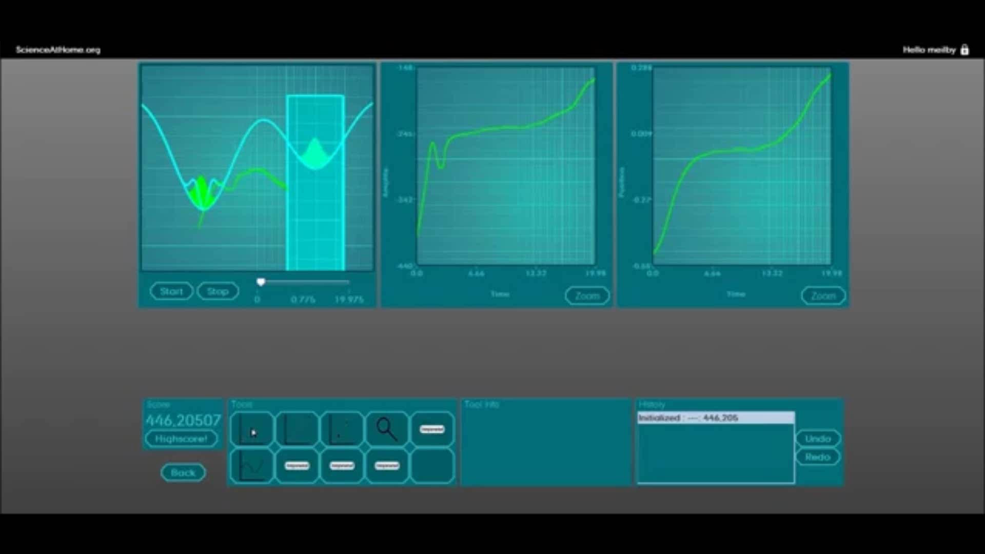
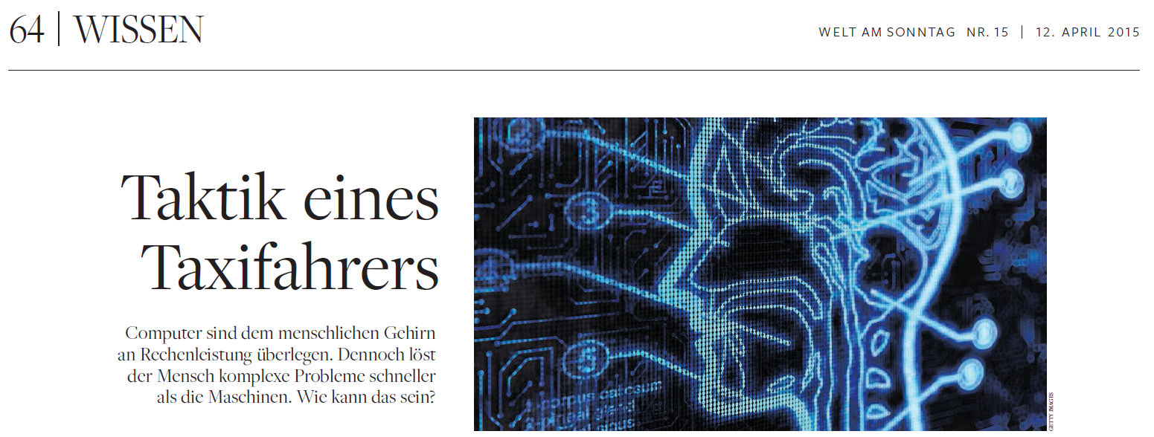
Unique player strategies
Meilby: #4596 games, Rank 6
“…figured I was letting them merge too fast because the first atom was what I would say too excited, and not going to relax. Then I had to be patient, when they were merging, and with some patience letting it flow in itself when they got near each other.”

Slide 16
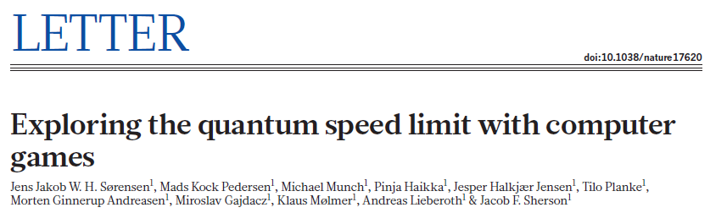
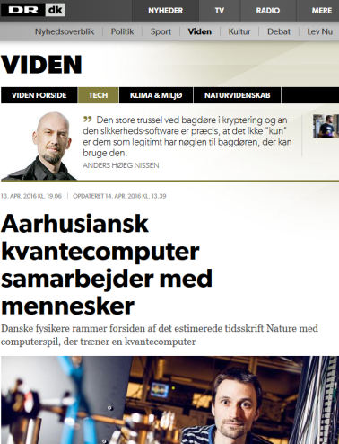
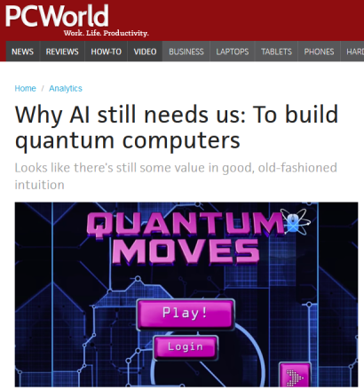
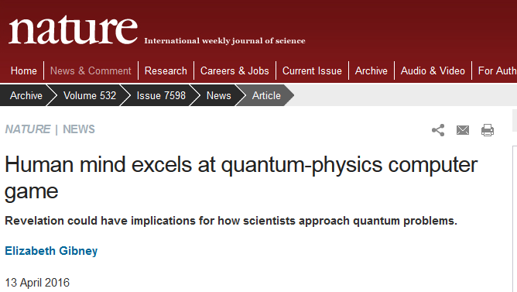
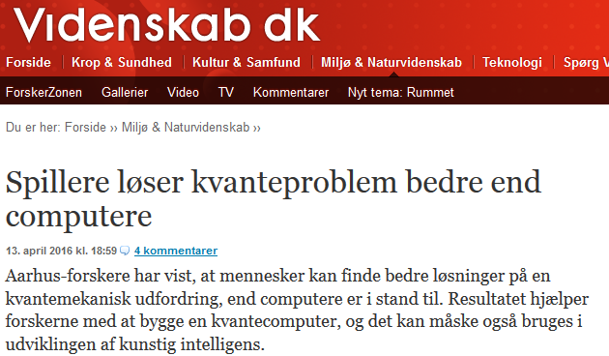
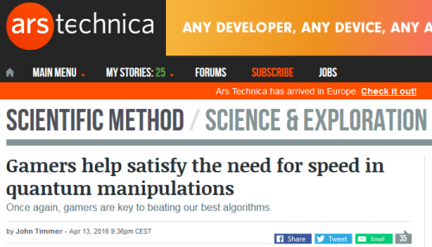
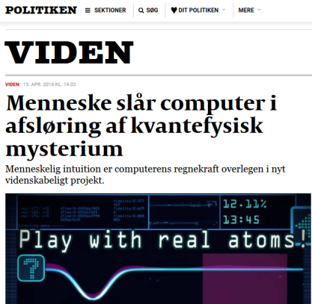
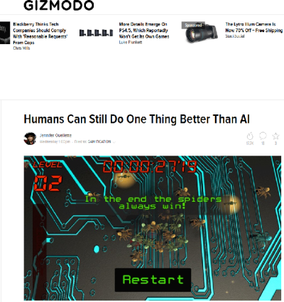
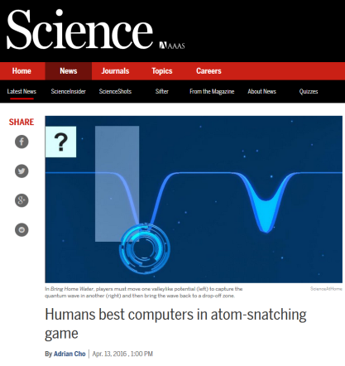
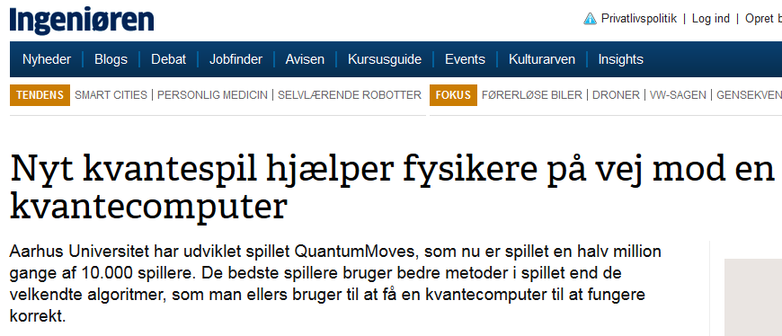
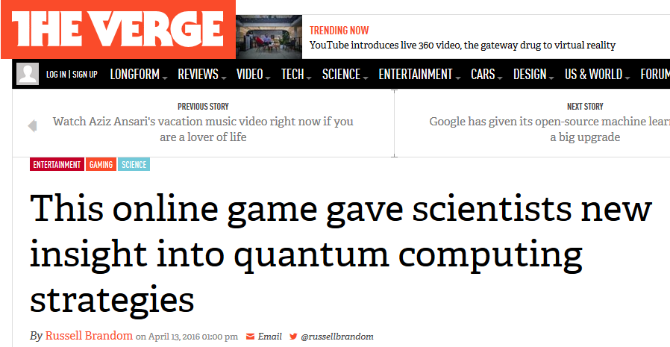
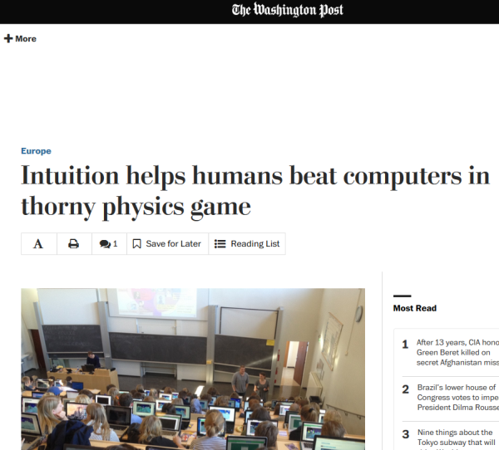
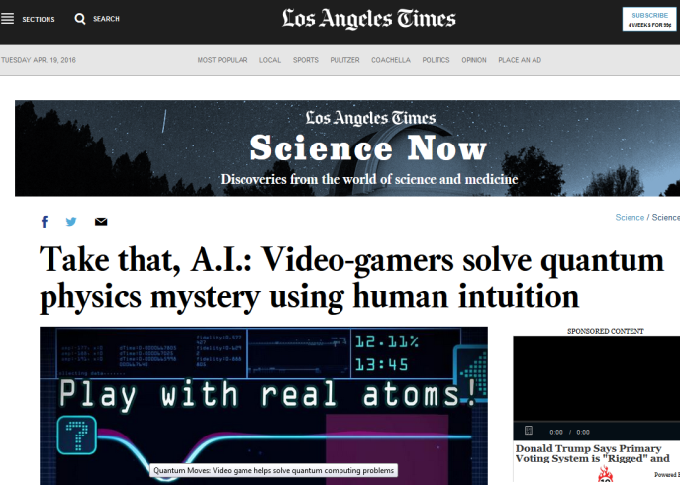
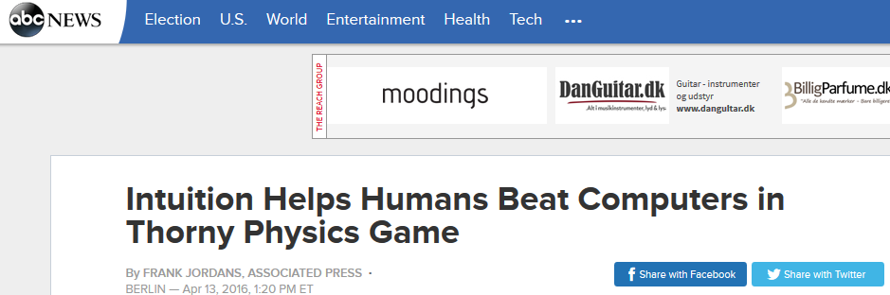

Slide 17

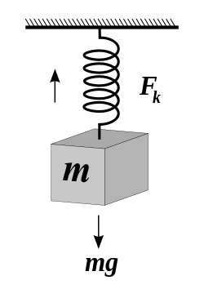
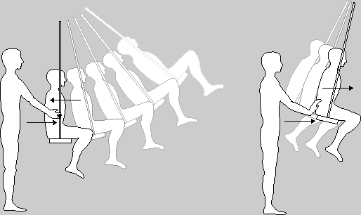

Quantum vs classical physics
Classical analogies:
Harmonic oscillator

Slide 18

Turbulence from teakettles to exploding stars from hurricanes to computer games

Slide 19

Orion nebula
Orion nebula
We experience turbulence every day on the ‘human scale’ when we boil water for our coffee.
This turbulence dissipates in a matter of seconds.
Why is turbulence good for our coffee? Turbulence causes coffee particles to separate and thereby allow for more vigorous interaction with the water flow.

Slide 20


Jupiter’s Great Red Spot
A storm that has been turbulent for 350 years.
larger than the Earth
Ongoing turbulence for
at least 350 years.
No complete dissipation
seen as yet !
Notes:
The reason the storm has continued to exist for centuries is because of the physical nature of Jupiter. As there is no planetary surface to provide friction only a liquid core of hydrogen, circulating gas eddies persist for a very long time in the atmosphere because there is nothing to oppose their angular momentum.

Slide 21


Storm in 2010
Storm in 2011
Saturn’s White Spot
Peroidic storms due to seasonal cooling in the atmospheric layers are highly turbulent
Turbulence dissipates in 28.5 years

Slide 22

Orion nebula
Why do some stellar nurseries give rise to ordinary stars like our sun and others can pop out stars 15 to 30 times as massive ?
Turbulence may be the answer !
Turbulence dissipates in 100,000 years
Turbulence in our solar system took
800,000 years to dissipate !
Notes:
Scientists have long known that stars are formed from swirling clouds of gas and dust that coalesce. Even when conditions like temperature, density and gravity are uniform for a smaller region in the nebula, some of these stellar nurseries give rise to ordinary stars like our sun and others can pop out stars 15 to 30 times as massive. Turbulence may be the answer !

Slide 23

Why does it take so much longer for dissipation to occur on the astronomical scale? The dissipation is driven by the ‘heat equation’ part of the Navier-Stokes Equation.
As you can see, time scales as physical space squared. So the larger the physical scale is, the larger the time is. The scale is referring to the scale of the ‘eddies.’
Also, the friction (viscosity) coefficient is usually very small in space. This is the parameter k in the equation above.

Slide 24



When a hurricane forms, meteorologists use probes to learn more about what is happening with the strength and direction of the winds.
Meteorologists make maps to locate the areas of high vorticity because to study turbulent dissipation you need to look where the ‘action’ is concentrated.

Slide 25



Remember, velocity is how fast something is moving (and in what direction) and vorticity is how much it is rotating
When the vorticity maximum is above a certain threshold, we identify that region, and analyze it carefully. In these regions, vortex structures are produced.
These are the structures seen in the Turbulence Game. However, our structures come from simulated data, rather than experimentally collected data.

Slide 26

In the game we are measuring the scale of these regions. When the scale of these vortex structures becomes small enough (in comparison to the magnitude of the vorticity), they should start dissipating.
This is one of the basic principles of turbulence.
If they did not begin to dissipate, the hurricane would keep growing and growing without ever stopping. This process would be known as a ‘singularity’ event.

Slide 27
Turbulence from teakettles to exploding stars from hurricanes to computer games

Slide 28
Our overall strategy
Cognitive/social
Science – understanding human (inter)actions
Hybrid intelligence through Citizen
science
Machine learning
Natural science – high dimensional complex optimization
scienceathome.org
So far: 250k+ players

Slide 29









The reproducibility crisis of science
The WEIRD-crisis in social science
Social science so far has mainly been confined to lab studies involving students or graduates who are Western, Educated, Industrialized, Rich and Democratic
1/3-1/2 of studies could be reproduced

Slide 30








The social science super collider
Complexity
Notes:
x

Slide 31

Virtual world simulator
What are the effects of different policies on economic inequality?
What are the causal effects of American vs. Danish systems of government on a given population?
Do the macroeconomic policies enacted by central banks (e.g. ECB, Federal Reserve) actually work as intended?

Slide 32




The first super collider games
Can we understand creativity/innovation?
Individual strategy selection
Collaborative search
Q. Minds: learning
Collaborative construction
Game theory / Behavioral econ
Gamified cognitive profiling

Slide 33
Quantum Minds: Predicting future learning

Slide 34

Quantum Minds: Predicting future learning

Slide 35

Quantum Minds: Predicting future learning

Slide 36


Quantum Minds: Predicting future learning
Prediction data
Training data

Slide 37

Extracting personality traits with games: Tower game
85 Game Features:
- Time between clicks
- Uniqueness of shape
- Growth rate
- Width of foundation
- Reaction time to collapses
- etc.
Constructs:
- Risk aversion
- Resiliency
- Attention to detail
- Creativity
- Need for cognition
- Big Five (control for team trial)
Applications:
Bulk data analysis
Personalization/ customization (user-experience, education, …)
Diagnostics (health)
Employment
Team formation
…

Slide 38






Notes:
Massive online game based cognitive profiling effort
Base line for cognitive illnesses
Team formation
Personalized education

Slide 39
THINK
LIKE A
SCIENTIST
Jacob Sherson
LAMAP 18/1-18

Slide 40





Think Like a Scientist (TLS), global educational initiative started this summer
Mission: Think Like a Scientist (TLS) seeks to create a movement that recognizes, connects, and expands the efforts of individuals and organizations seeking to stimulate all students to think like scientists living in an emergent universe.
Current Partners (27):
TLS/USA includes 7 major Unis, AIP, APS, AAAS, Exploratorium +…
Advisory commitee including 3 Nobel Laureates, President AAAS + NAS
Leadership team
Notes:
Think about how to say it/which order
Our experiment in near future.
Conservative arbitrary potentials, which allow e.g. for the creation of distinct microtraps. These microtraps can be probed individually non-destructively, thus also able to use the induced dynamics of measurement backaction.Finally an optical lattice with single site addressing and imaging.

Slide 41
”ONE MILLION new science, engineering and technology professionals will be required in the UK by 2020."
Royal society STEM needs report
Global Connectivity
Game-based Education
Personalized Education
3 global trends
Known problems
Can create information overload
Often fails to create genuine motivation
Requires immense AI-training data
Global, curated sharing network for learning material
(teacher trajectory creation tool)
True epic motivation* by linking citizen science engagement directly with core curriculum
(Research-Enabling Game-Based Education, Researcher class competition)
Novel game-based psychological profiling approach for personalization
TLS-SAH solutions
*To be inspired to be a passionate participant in something important that is bigger than ones self
Notes:
Going to Carol, this slide is just fine, however if it was an external organization (more general audience). For a broader audience there needs to be a slide between slide 2 and slide 3 that tells what TLS is trying to solve.
Does Carol/David/TK know what ’epic motivation’ is ? : *to be inspired to be a passionate participant in something important that is bigger than ones self.

Slide 42
TLS-Proposal 1: Research-Enabling Game-Based Education (REGAME)

Slide 43
Why Research-Enabling Game-Based Education (REGAME)
REGAME increases student motivation
By providing epic meaning through a direct link between the core curriculum and front-line R&D challenges (i.e. global sustainability goals)
By demonstrating to the students that knowledge is not static but can be expanded/explored even without a graduate research education (open ended exploration)
By turning normal teaching upside down: first explore the engaging/epic perspectives of the subject matter using a powerful yet intuitive interface and then "open the hood of the Ferrari" to understand the underlying formalism.
“Gifted”
Under explored
Intuition
Analytical
“Challenged”
Notes:
*perhaps provide a link to something for epic meaning
*What do the underlined words mean? What is their importance
I am not sure how the graphic fits to the concept of the slide: I dont have strong feelings for it either way. It seems like it leads into a topic that is not discussed – it is an intriguing side thought. (personally I wouldn’t worry about it at this moment)
Do you know very specifically what the definitions of gifted/challenge are? These might have different contexts in the states. How to see how many people are gifted. Perhaps change gifted to Inspired?

Slide 44


REGAME as Multidisciplinary Topics

Slide 45






REGAME as non-formalistic progression (in and out of the digital world)

Slide 46


Timeline
Presence of general TLS
material
Launching REGAME through National competition: Denmark’s Researcher Class
Presence of REGAME
Research-Enabling Game-Based Education

Slide 47
Launching REGAME
Research class competition is a broad knowledge competition for students from public school 7th-12th grade (upper public school and gymnasium in Denmark) aimed at integrating the ReGAME concept into the school system. Timeline
2018: Estimated 5-20.000 participants in Denmark.
2019: International/US 100.000 participants.
2020: Open competition for everyone. The competition is an extra-curricular competition running from the 24th to 30th September 2018.
Guidelines: A group of min. 10 students (must be in the same class) join together as a team. Each team will compete against all other teams in a set of different topics related to actual science research topics (through citizen science games) and associated core curriculum learning modules including games, interactivities, learning video/texts and multiple-choice test. The total points from all topics are compared during the competition-week and a winner will be found at the end of the competition. The winning team will be giving a prize of xxx.xxx DDK. (e.g. for travel to a science place in the world.)

Slide 48
TLS-Proposal 2: Shared economy for learning, Open Source Learning Trajectories

Slide 49

Proposal two: shared economy for learning, Open Source Learning Trajectories
Problem description
Today teachers spend too much time putting together appropriate IBSE/TLS related teaching modules.
Although multitudes of modules are available, teachers lack suggestion systems for how to progress from a particular modules, or how to offer differentiated education in the class room.

Slide 50
Proposal two: shared economy for learning, Open Source Learning Trajectories
Tool description
Global accessibility of TLS partner modules
Meta-tagging each module according to topic, levels, learning goals, interaction form…
Interrelatedness and progression tree of all subtopics within a given field (e.g. physics from 7th-12th grade)
AI-based framework for construction of learning trajectories (sequence of modules) from various web sources based teacher key words and then on match to meta-tags and subtopic relatedness.
Functionality for teacher up-and down voting of particular module sequences/connections and accompanying AI training.

Slide 51
TLS-Proposal 3: Personalized education through game differentiation and individual cognitive profiling

Slide 52

Personalized education through game differentiation and individual cognitive profiling
Implementation and Adaptation
Games provide an easily adaptable tool to personalize individual student’s learning style by shifting modes of gameplay and game level progression.
These proposed personalized education tracks can perhaps also be enhanced through the use of cognitive profiling from the cognitive science games
Notes:
When we have games its very easy for us to change the interaction and the different modes of game play and progression modes – augmented by the personalized profiling for the games

Slide 53

Personalized education through game differentiation and individual cognitive profiling

Slide 54




















Interdisc. research center: CODER
Machine learning
Physics
Arthur Juliani, OregonU
Psychology/anthropology: formation of groups, reward structure
Lars Kai Hansen, DTU
Andreas Lieberoth
Rupert Young, perceptual Robots
Christian Storm Pedersen
Rajiv Basaiawmoit, AU
Ole Eggers Bjælde, CSE
Didactics
Ralph Hertwig, Max-Planck, Berling (cognitive neuroscience, heuristics)
Niels Bonderup Dohn, DPU
CODER
Cognitive research, Decision making
Corporate innovation
Jana Jarecki, Max Planck, Basel (cognitive science)
rv
Oana Vuculescu, Carsten Bergenholtz (BSS)
Behavioral economics
Karim Lakhani, Maroc Iansiti (HBS)
Andrew Mao, Microsoft
Alexander Koch (BSS)

Slide 55










The hard working teams
Please ☺ and follow us
@QuantumMoves
scienceathome.org
Janet Rafner
There is lots of potential for collaborations, so please contact me… sherson@phys.au.dk
Vores sponsorer:

Slide 57


Slide 59







Citizen science
7 billion research leaders
User derfined task
Citizen science V2.0
User innovation
7 billion research assistants
Researcher derfined task
Time
Dificulty level
Skills

Slide 60
Citizen science
7 billion research leaders
User derfined task
Citizen science V2.0
User innovation
7 billion research assistants
Researcher derfined task
Time
Dificulty level
Skills

Slide 61




Teaching modes
Main teaching hypotheses:
Presenting the curriculum in a research relevant context increases the motivation to learn.
Game-based education activates and motivates
``Most ibooks for school today are simply slightly improved normal books``
High school, physics teacher
Fun and engaging
A. Lieberoth et al Getting humans to do quantum optimization - user acquisition, engagement and early results from the citizen cyberscience game Quantum Moves, J. Human Comp., 1 (1) 2014
O Bjælde et al, Gamification of Quantum Mechanics Teaching, arxiv.org:1506.08128
R. Magnussen et al, Games as a Platform for Student Participation in Authentic Scientific Research, EJEL (2014)
Motivation for curriculum

Slide 62










There’s more to games than Points-Badges-Leaderboard (PBL)- gamification
Game-based education has been proposed to solve scalability and motivational challenges in 21st century education but has been attacked for being ”chocolate covered broccoli” (educational but not fun, or fun but not educational)
Study 1: Virtual learning environment for interactive engagement with advanced quantum mechanics
Study 2: Leaderboard Effects on Player Performance in a Citizen Science Game
Study 3: Studying player behavior versus the “framing” (beh. econ.)
Participation in the VLE lead to enhanced learning (grade)
Surprise: even some of the best students turn off the high score!
No significant difference between ~5000 new players w/ 3 different leaderboards
Pedersen et al, Phys. Rev. Ed. 2016
Pedersen et al, ECGBL 2017
Lieberoth et al, on-going studies

Slide 63




Personalized teaching: Cross correlations
General approach:
Find generic types of students (Mastery vs performance, Gamer?, …)
Correlate the success/failure of each aspect with student types
Find the optimal teaching strategy for each type = personalized teaching
Performance: I would like to be better than my fellow students
Mastery: I like assignments where I learn something even though I make many mistakes along the way

Slide 64


Personalized teaching: pre-post testing
Investigating the effect of physics teaching on Quantum Moves game performance (high school)
Vidovic et al., in preparation

Slide 65



Tower game: Experimental design
mTurk experiment:
In progress
1000 workers
Play game and answer survey
Build and validate Game Data to construct model
85 game data features
10 constructs
Partial-least squares regression
Model construction
UNLEASH experiment:
Summer 2017, 2018
1000 participants
Play game, answer survey, and participate in UNLEASH
7 sustainability challenges
2 weeks
Teams of 5
Can team performance be predicted from individuals game data
Aarhus Class experiment:
Winter 2017
125 participants
Play game and participate in innovation course
7 weeks
Teams of 5 based on data from UNLEASH experiment
Validate team composition model

Slide 66
Potential profiling traits
Basic psychological processes
Attention
Perception
Memory
Emotion
Motivation
Sensation
Focused
Visual
Acoustic
Working memory
Long term memory
Autobiographical memory
Prospective memory
Primary emotions
Interest theory
Visual
Divided
Movement
Phonological Loop
Secondary emotions
Intrinsic motivation (Reiss 16 basic factors)
Auditory
Static
Visuo-spatial sketchpad
Positive emotions
Extrinsic motivation
Olfactory
Inter-categorical
Central executive (attentional system)
Negative emotions
Self-determination (medina 2005)
Somatosensory
Intra-categorical
Recognition
Expectancy theory
Colour
Attribution theory
Facial

Slide 67
Potential profiling traits
Higher psychological processes (Thinking)
Reasoning
Language
Consciousness
Executive functions
Problem solving
Decision making
Deductive reasoning
Inductive reasoning
Abductive reasoning (six modes of Peirce)
Scientific reasoning
(Visuo) Spatial reasoning
Physical reasoning
Statistic reasoning
Moral and interpersonal reasoning
Everyday (common-sense) reasoning
Language comprehension
Language production
Metacognition
Reaction times
Puzzle problems (Jonassen)
Judgement and bias
Conditional reasoning
Causal inferences
Problem identification
Spatial perception
Rigid object kinematics
Reasoning on data
Written
Written
Metarepresentation (TOM)
Attentional control
Well structured problems
DM under Certainty
Syllogistic reasoning
Categorical inference
Questioning
Mental rotation
Rigid object Dynamics
Reasoning on representation of data
Listen
Speech
Inhibitory control
Ill structured problems
DM under Uncertainty
Analogy
Hypothesis generation
Spatial visualisation
Liquids (Davis)
Reasoning on statistical measures
Cognitive inhibition
Dilemmas
Dilemmas
Construction of artefacts
Reasoning on uncertainty
Reasoning on samples
Cognitive flexibility
Evidence generation
Planning
Reasoning on association
Evidence evaluation
Working memory
Drawing conclusion
Prospective memory
Communication and scrutiny
Time-based planning
Multitasking

Slide 68




Creating many more natural science R&D games
How could natural science change our world?
Math/Physics: Turbulence
Stat-World, data-science game
Quantum computers
Chemistry: NMR
Exp. q. physics: remotecontrol
Computer science: NP-hard problems

